Slide 1
Surface Collisions and the Coefficient of Restitution
Dr. Jacob Moore
Associate Professor of Engineering
Penn State Mont Alto

Slide 2
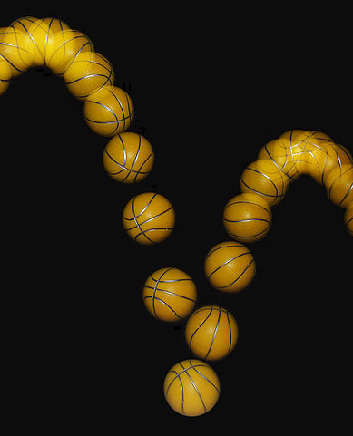
Surface Collisions
A surface collision is any collision where some moving body bounces off an immovable surface.
A basketball bouncing off a floor is an example of a surface collision
In these instances, the moving body will have some pre-collision (initial) velocity as well as some post collision (final) velocity, which we will relate to one another using the coefficient of restitution.

Slide 3

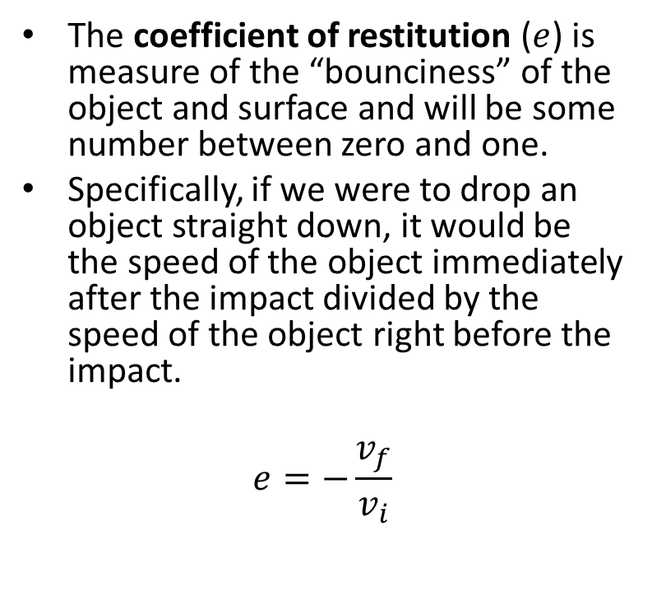
The Coefficient of Restitution
The coefficient of restitution ($e$) is measure of the “bounciness” of the object and surface and will be some number between zero and one.
Specifically, if we were to drop an object straight down, it would be the speed of the object immediately after the impact divided by the speed of the object right before the impact.
$$e=−\frac{v_{f}}{v_{i}}$$
$$v_{i}$$
Impact
$$v_{f}$$

Slide 4
The Coefficient of Restitution and Types of Collisions
Perfect Bounce
Elastic collisions:
Nothing is truly elastic, but rigid bodies colliding without permanent deformation can get close.
100% of the kinetic energy is conserved.
$e=1$
Semi-Elastic collisions:
Somewhere between elastic and inelastic.
Some energy is conserved, some energy is dissipated in the collision
$0<e<1$
Inelastic collisions
Occurs when there is no bounce at all.
All energy is dissipated in the collision
$e=0$
Some Bounce
No Bounce

Slide 5
Angled Impacts
In instances, where the object hits the surface at an angle, things get a little more complicated.
For example, in the instance below, $e≠−\frac{v_{f}}{v_{i}}$
$$v_{i}$$
$$v_{f}$$
$$θ_{i}$$
$$θ_{f}$$

Slide 6
Angled Impacts
In these instances of angled impacts, we will have break the motion down into motion that is perpendicular (normal) to the surface as well as motion parallel (tangential) to the surface.
Draw the normal and tangential directions on your diagram
Break any known velocities down into normal and tangential components

Slide 7
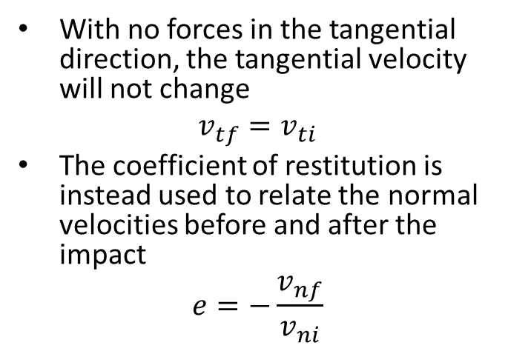
Angled Impacts
The reason we use the normal and tangential directions is because the impact force will always act in the normal direction, while friction forces from the impact are usually negligible.
With no forces in the tangential direction, the tangential velocity will not change
$$v_{tf}=v_{ti}$$
The coefficient of restitution is instead used to relate the normal velocities before and after the impact
$$e=−\frac{v_{nf}}{v_{ni}}$$
N
$$v_{i}$$
$$F_{impact}$$
$$v_{f}$$
$$θ_{i}$$
$$θ_{f}$$
T

Slide 8
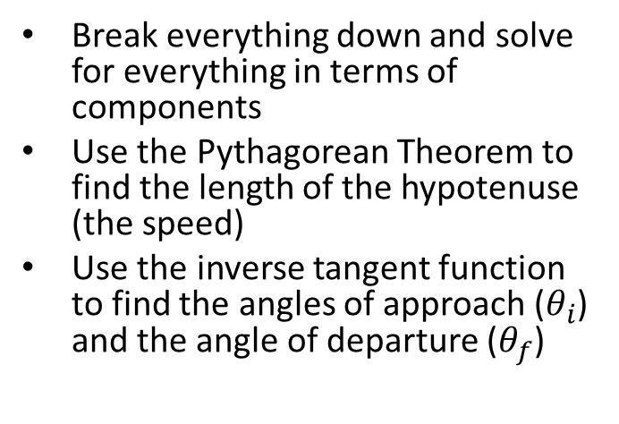
Angled Impacts
To find the angles of impact with the surface, or the speed before and after impact, we simply need to treat the velocities as vectors
Break everything down and solve for everything in terms of components
Use the Pythagorean Theorem to find the length of the hypotenuse (the speed)
Use the inverse tangent function to find the angles of approach ($θ_{i}$) and the angle of departure ($θ_{f}$)
N
$$v_{i}$$
$$F_{impact}$$
$$v_{f}$$
$$θ_{i}$$
$$θ_{f}$$
T

Slide 9
Solving a Collision Problem (The Process)
Solving collision involves three steps, carefully accounting for the factors at play between some initial state and some final state.
Set up a diagram showing the object bouncing off the surface
Identify the known or unknown velocities in each state, including magnitudes and directions
Identify the type of collision, and the coefficient of restitution if applicable
Identify the normal and tangential directions in your diagram
Use the diagram to break down velocities into the normal and tangential components, and use the equations discussed earlier to relate initial and final velocities
$v_{tf}=v_{ti}$
$e=−\frac{v_{nf}}{v_{ni}}$
Solve the equations for the unknown quantities

Slide 10
Thanks for Watching
See other engineering mechanics videos and access the full tool at…

Slide 11

Worked Example
A tennis ball is dropped from rest from a height of 3 meters. It impacts the ground and bounces back to a maximum height of 2 meters after the impact. What is the coefficient of restitution for the tennis ball on this surface?
3m
2m

Slide 12
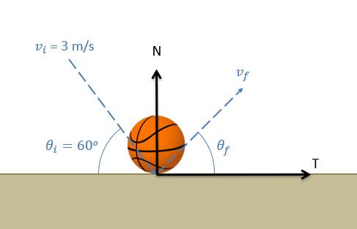
Worked Example
A basketball with an initial speed of 3 meters per second impacts a hard floor at the sixty degree angle as shown below. If the collision has a coefficient of restitution of .8, what is the expected speed and angle of the basketball after the impact?

Slide 13
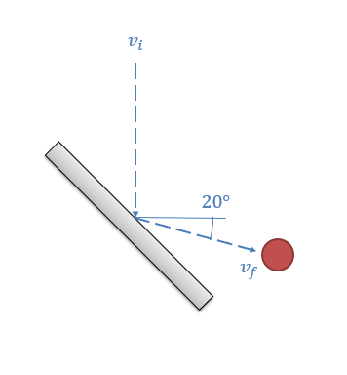
Worked Example
A bounce test is used to sort ripe cranberries from unripe cranberries. In this test cranberries are dropped vertically onto a steel plate sitting at a 45-degree angle. After the impact, a cranberry is observed to bounce off at an angle of 20 degrees below horizontal. Based on this information, what is the coefficient of restitution for the cranberry?

Slide 14
Worked Example
In an alternate cranberry sorter machine, cranberries are launched at a horizontal metal plate with an initial velocity of 2 m/s downwards at a 30-degree angle as shown below. The cranberries then bounce off the plate into one of two baskets, a closer one for bad cranberries and a farther one for good cranberries. If the cranberries are supposed to have a coefficient of restitution of 0.8 or greater, how far away should the edge of the good cranberry bucket be?
2 m/s
d
30º
Bad Berries
Good Berries

